Slide 1
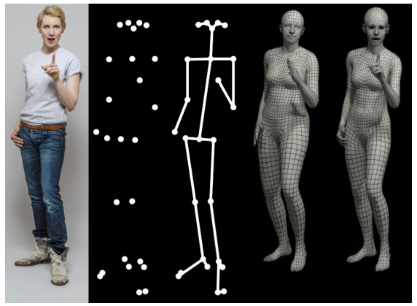
Expressive Body Capture: 3D Hands, Face, and Body from a Single Image
Thai Thanh Tuan, YoungSik Yun
corrected: 27th July 2021

Slide 2
Introduction
Code: https://github.com/vchoutas/smplify-x
Project page: https://smpl-x.is.tue.mpg.de/
Paper: Expressive Body Capture: 3D Hands, Face, and Body from a Single Image
Conference: CVPR 2019
Paper: https://ps.is.tuebingen.mpg.de/uploads_file/attachment/attachment/497/SMPL-X.pdf
Supplementary: https://ps.is.tuebingen.mpg.de/uploads_file/attachment/attachment/497/SMPL-X.pdf

Slide 3
Introduction
1. Compatibility with graphics software
2. Simple parametrization
3. Small size
4. Efficient
5. Differentiable
2D features:
Face/ hands/feet
Pose prior:
Neural network on large MoCap dataset
SMPL
SMPLify
New interpenetration
Fast + Accurate
SMPLify-x
Hand pose
SPML-X
Automatically detect gender
Facial expression
Pytorch implementation
X8 speed

Slide 4
Introduction
Capture major joints
Lack of 3D models
Lack of rich 3D training data
Understand human behavior
3D surface of body, hands and face
No previous system
Challenges

Slide 5
SPMLify-X
SMPL-X
model
Better performing pose prior from large dataset [50,51]
Image
Open pose
Fitting
New self-interpenetration
(still differentiable)
3D body with hands and face
Gender detector:
Male/female/neutral

Slide 6
Introduction
Human
Scanning system
Evaluation
Manually fitting
SMPL-X
Wide variety of poses
New evaluation dataset
Pseudo ground truth
Wide variety of gesture
Wide variety of expressions
Quantitative evaluation

Slide 7
Related work
Modeling the body
Faces model
FLAME [43], models the whole head
Captures 3D head rotations
Models the neck region
No correlations in face shape and body shape
Hands model
MANO [68]
Rich shape and pose space using 3D scans of 31 subjects
51 poses
Following SMPL formulation
Unified model
SMPL+H[68]
We start from
SMPL+H
FLAME
Inferring the body:
Estimate SMPL model from single image: [37,41,59,62]
In [36]:
Capture environment is complex:
140 VGA cameras for the body
480 VGA cameras for the feet
31 HD cameras for the face and hand keypoints
➔ use a single RGB image

Slide 8
Technical approach:
Unified model: SMPL-X
SMPLify-X: SMPL-X from a single image
Variational Human Body Pose Prior
Collision penalizer
Deep Gender Classifier
Optimizatiton

Slide 9
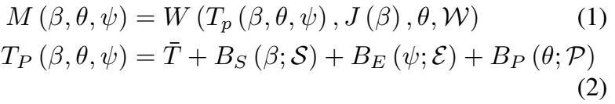







Unified model: SMPL-X
Neck
Jaw
Eyeballs
Fingers
N = 10475 vertices
K = 54 joints
SMPL-X
The facial expression parameters
body, face and hands shape parameters
K joints + global rotation

Slide 10




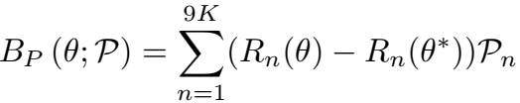






Unified model: SMPL-X
the expression blend shape function
PCA coefficients
the expression blend shape function
the shape blend shape function
the pose blend shape function
the pose vector of the rest pose
Orthonormal principle components of vertex displacements capturing shape variations due to different person identity
Orthonormal principle components of vertex displacements

Slide 11



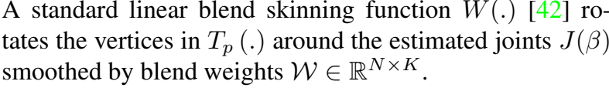
3D joint locations
linear blend skinning function
sparse linear regressor

Slide 12




SMPL-X
Four datasets of 3D human scans
3800 alignments in A-pose, variations across identities[67]
Training body shape
3D Template
Fitting
How???
3D alignments
Training data
1786 alignments in diverse poses
Training body pose
Artist designed
Face and hands match the templates of FLAME[43] and MANO[68]
Limited resolution for the hands and face
Use pose space and pose corrective blend shapes of MANO(1500 hands)
Use the expression space of FLAME (3800 head)

Slide 13


MANO PCA pose space
PCA coefficients
Principal components
Finger joints: 30
Finger pose parameters: 90
PCA
Trained on large dataset of 3D articulated human hands
3DoF / joint

Slide 14







SMPLify-X: SMPL-X from a single image
the full set of optimizable pose parameters
VAE-based body pose prior
priors for the facial pose
priors for the hand pose
priors for for unnatural bending only for elbows and knees.
priors for the body shape
Facial expressions
an interpenetration penalty
The body pose parameters are a function
the pose vectors for the body, face and the two hands

Slide 15





Data term
Re-projection loss to minimize the weighted robust distance between estimated 2D joints
3D joints of SMPL-X
body, hands, face and feet keypoints
Estimated 2D joints
(OpenPose)
Calculate distance
Projected to 2D
Intrinsic camera parameters K
robust Geman-McClure error function
confidence score from OpenPose
per-joint weights

Slide 16
Variational human body pose prior
Approximation to the negative log of a Gaussian mixture model trained on Mocap data
SMPlify body pose prior
Not sufficiently strong
Training data: 1M poses
Test data: 65K poses
in rotation matrix representation
Training Data from [50,51]
Variational Autoencoder [40]
Use
SPMLify-X
VPoser
Latent representation of human pose
Training loss

Slide 17

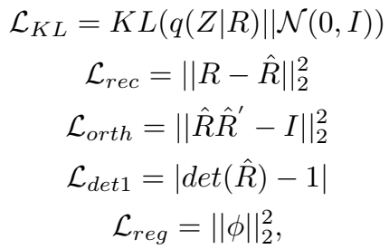

Variational human body pose prior
Training data: 1M poses
Test data: 65K poses
in rotation matrix representation
Training Data from [50,51]
Variational Autoencoder [40]
VPoser
Latent representation of human pose
Training loss
encourage a normal distribution on the latent space, and to make an efficient code to reconstruct the input with high fidelity
follow the VAE formulation in [40]
encourage the latent space to encode valid rotation matrices
prevent over-fitting by encouraging smaller network weights

Slide 18
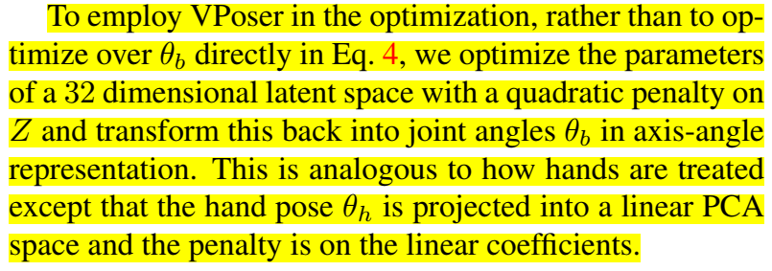
Variational human body pose prior
Still not clear this.

Slide 19
Collision penalizer
Prevent the body penetration
Developed from SMPLify and can apply in finger and facial expression
SMPLify
Too approximate
SMPLify-X
More exact
To express the finger and facial expressions
Capsule
&
Sphere
Triangle
(mesh-face)

Slide 20
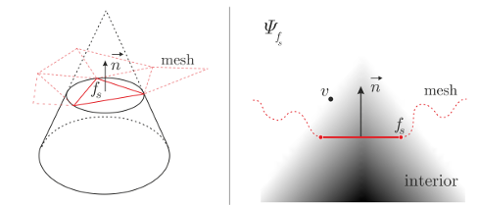
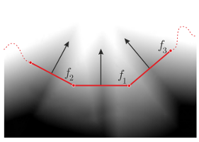
Collision penalizer
Search colliding triangle by BVH
List of Colliding triangle
Get distance field
(draw conic)
Calculate collision term

Slide 21
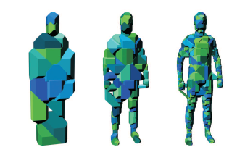
BVH
Place the bounding volume of the object in a tree called BVH.
Time complexity is logarithmic.
When the bounding box collide, the objects in the box collide.
Check the collide while increasing the depth.
Don’t check the hierarchy that collide in the previous depth.
Depth:1 depth:2 depth:3

Slide 22
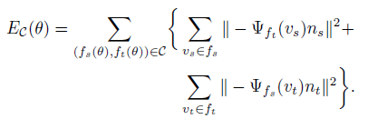



Formular
Collision term
Because the intrusion is bi-directional, they have two terms.
Fs can be intruder and receiver
Distance field
-if is smaller then 1, the vertex is in the cone. Else it is
out the cone, so we don’t give a penalty
A measure of whether a vertex is in a cone.
Molecule means the distance between vertex to axis.
The denominator approximates the radius of the cone at the height of the vertex.
Intensity of repulsion
x is the height of the vertex

Slide 23
Deep Gender Classifier
No previous method that automatically takes gender into account.
LSP, LSP-extended, MPII, MS-COCO, LIP
datasets
Image
Gender classification
Gender
Openpose joint
Amazone Mechanical Turk
ResNet 18:
Binary gender classification
50216 training samples
16170 test samples

Slide 24
Optimization
SMPLify
Chumpy
Slow
OpenDR
Known focal length of the camera
SMPLify-X
PyTorch
Limited-memory BFGS optimizer
(L-BFGS)

Slide 25

Optimization
On torso joints
SMPL-X
Camera translation and body orientation are unknown
The camera focal length or its rough estimate is known.
Side view
Starting with high value then decreasing
Torso length of mean SMPL shape
Via the ratio of similar triangles
Initialize the camera translation
Estimate depth
Estimating camera translation
Fitting by minimizing Eq. (1)
Using Powell’s dogleg method [31]
Assumption
The person is standing parallel to the image plane
fix to mean shape
Predicted 2D joints

Slide 26





Optimization: hyper parameters
Facial KJ.
Increase influence of hands arm
Small body parts like the hands and face → a lot of keypoints
Focus on body pose
Can dominated in Eq. 4
Local optimum (bad initializatiton)
Weights for joints

Slide 27
Experiments
Evaluation datasets
NO dataset with ground-truth shape for bodies, hands and face together.
➔Create a dataset for evaluation.
Expressive hands and faces dataset (EHF)
SMPL+H dataset [52]
RGB image per frame
Align SMPL-X to 4D scans following [68]
Better than 3D joint error
Vertex-to-vertex error metric [48,62]
Pseudo ground truth
(100 frames)
Expert annotator manually

Slide 28
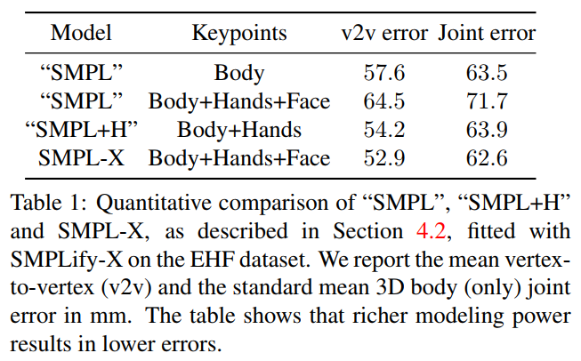
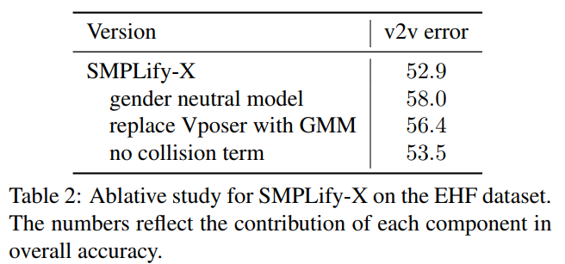
Qualitative & Quantitative evaluations
Use less inputs than previous works

Slide 29
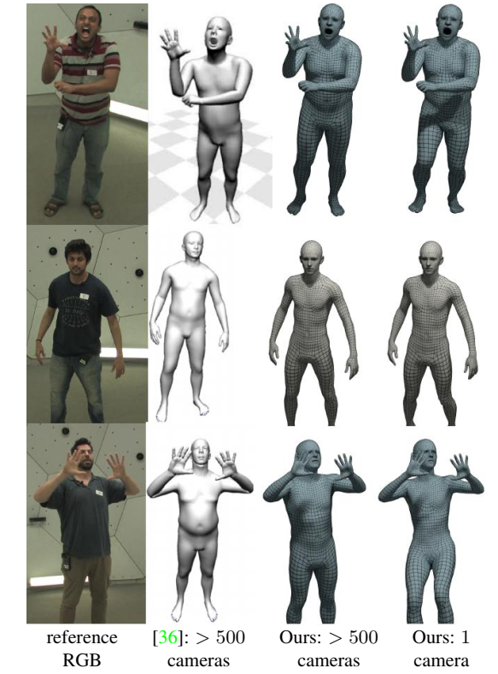
Neutral model →
SMPL-X: +No artifacts around the joints: elbows…
+Less inputs
specific model →
Neutral model →

Slide 30
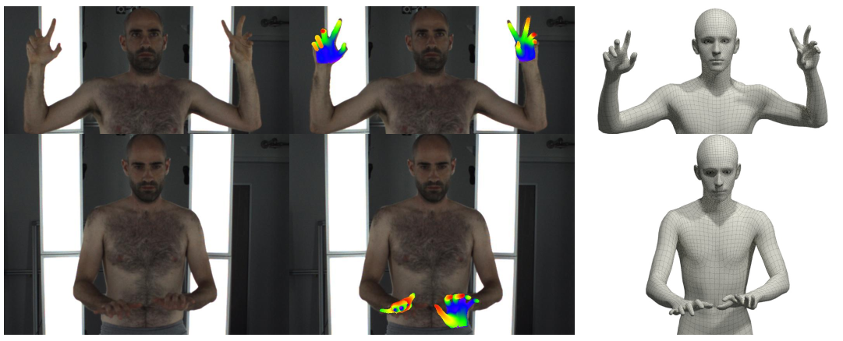
Hand only
Good 2D Joints Detector→
Bad 2D Joints Detector→

Slide 31
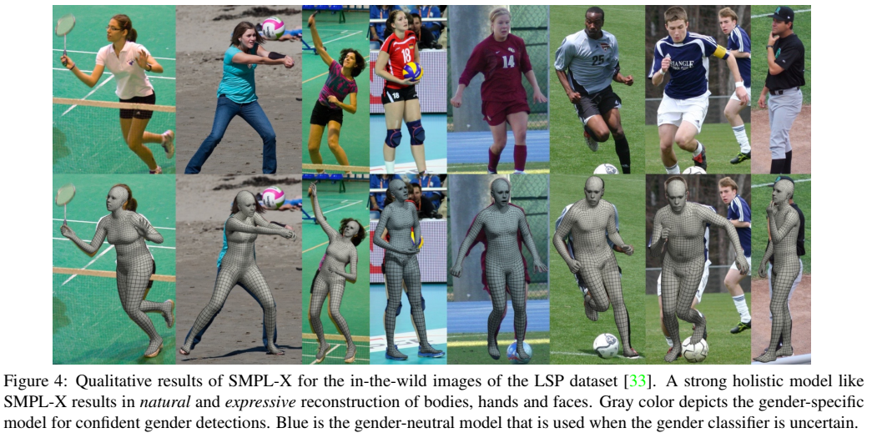
Qualitative results

Slide 32
Conclusion
SMPL-X: model with body, face and hands.
SMPLify-X: fit SMPL-X to single RGB image and 2D Open Pose joints.
New body pose prior: fast and accurate
Introduce a curated dataset with pseudo ground-truth.

